Slide 1

Non Linear Hyper Spectral Image Unmixing
U. Pavithra
222SP030
II Semester, M.Tech., SPML
Guided by,
Dr. Raghavendra B.S.
DEPARTMENT OF ELECTRONICS AND COMMUNICATION ENGINEERING NATIONAL INSTITUTE OF TECHNOLOGY KARNATAKA SURATHKAL, MANGALORE - 575025

Slide 2
Outline
Problem Statement
Motivation for Non linear Unmixing
Literature Review
Linear Mixing Model
Non Linear Mixing Model
Architecture
Loss Function
Results

Slide 3
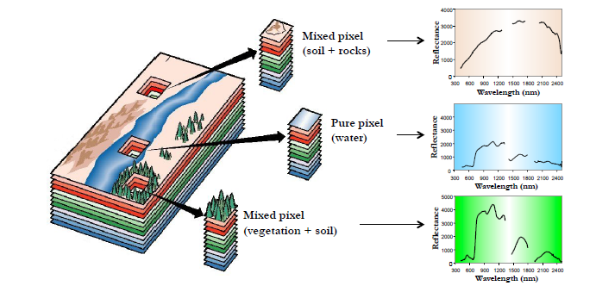
Problem Statement
HSI technique that analyses wide spectrum of light
The spectral unmixing problem aims at recovering the spectra of the pure materials of the scene called endmembers, along with their proportions called abundances in each pixel
Figure 1: : Mixed pixel and pure pixel in Hyper spectral image [1]

Slide 4
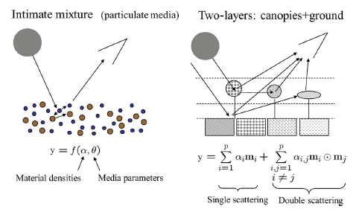
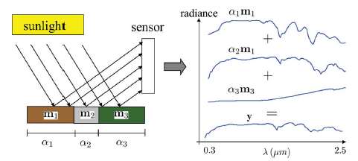
Motivation for Nonlinear Unmixing
Mixed pixels occur due to low resolution of Hyper spectral images captured by satellites
Mixed Pixels can be modelled in two ways-Linear and Non Linear
Multiple scattering between components is not considered in linear methods
Figure 2: Illustration of linear and nonlinear mixing where incident solar radiation encounters an intimate mixture that induces multiple bounces [1]

Slide 5
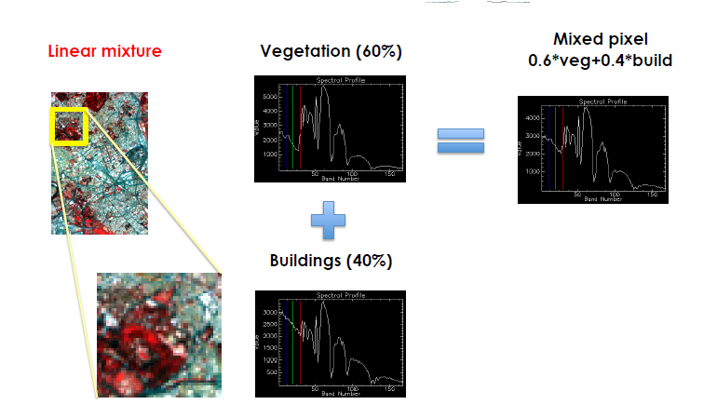

Literature Review
Linear Mixing Model
m_{k} = mth endmember
a_{k}=mth abundance of e_{m} endmember
Steps involved in LMM:
1. Dimension reduction
2. Endmember determination
3. Estimation of endmember spectra and fractional abundance
Figure 3: Example for Linear Mixing Model

Slide 6
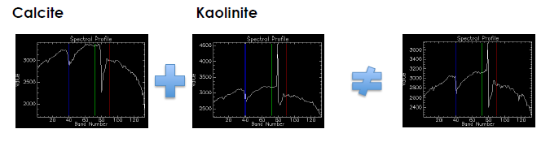

Non Linear Mixing Model
Bilinear mixing Model
y = [y₁, . . . , y_{L}]^{T} of a mixed pixel
endmember spectra m_{k} = [m_{1,k}, . . . , m_{L,k}]^{T}, k = 1, . . . , R,
α = [α₁, . . . , α_{R}]^{T} is the fractional abundance vector,
(iv)n = [n₁, . . . , n_{L}]^{T} is an additive white noise sequence. n ∼ N(0,σ²I_{L})
Shortcomings:
1. Bilinear term involves the multiplication of two endmember spectra which are smaller than one, it will have a smaller magnitude than the actual endmembers. This is further exacerbated in several models where these bilinear interaction terms are multiplied with other parameters that are smaller than one. 2. The exclusion of self-interactions encountered in many bilinear models.

Slide 7

Dataset
Dataset Available in .mat format
Table 1: Summary of Dataset used

Slide 8
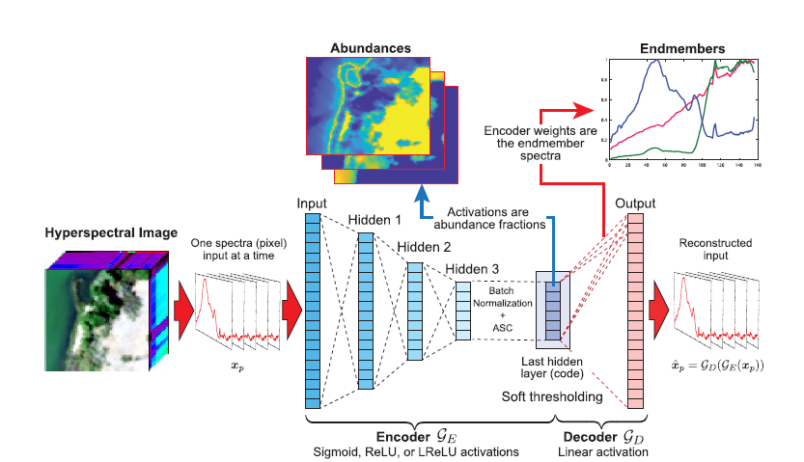
Architecture
Figure 3: The autoencoder is trained on all the spectra in the HSI for a number of epochs. After training, abundance maps can be extracted as the activations of the last hidden layer for each input spectra, and the weights of the decoder are the endmember spectra. [3]

Slide 9
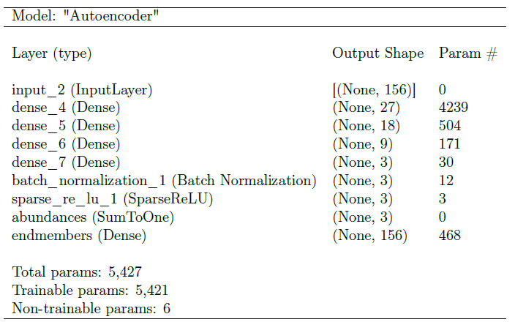
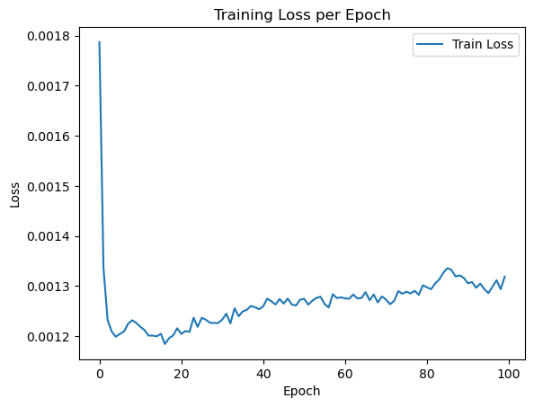
Hyperparameter Tuning
Table 2: Model Summary of Autoencoder
Batch size - 6
Learning rate - 0.001
epochs - 100
loss – SAD/MSE
optimizer - Adam
Figure 5: Loss Curve for training on Urban4 dataset with MSE loss function

Slide 10


Loss Function
Objective Function used for experiment are,
1.Mean Squared Error(MSE)
2. Mean Spectral Angle Distance (SAD)
SAD is scale invariant while the MSE function is not

Slide 11
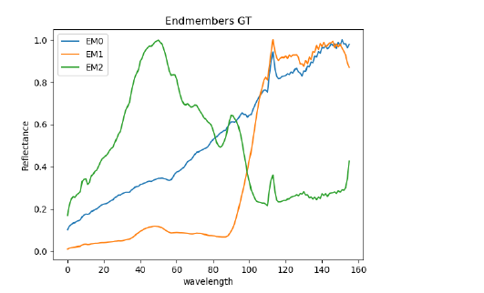
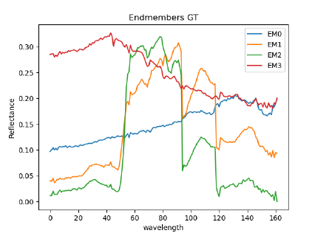
Results
Expected output -For a given HSI, the abundance maps for the identified end members is displayed as output
Figure 4:The ground truth spectra of endmembers of Samson dataset: Soil, Tree and Water
Figure 5:The ground truth spectra of endmembers of Urban4 data set: Asphalt, Grass, Tree and Roof

Slide 12
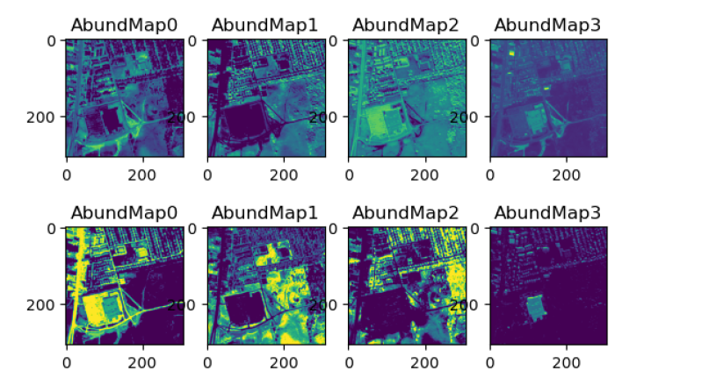
Figure 6: The resultant abundance maps of Urban4 dataset(Asphalt, Grass, Tree and Roof) using objective function MSE(top) and SAD(bottom)

Slide 13
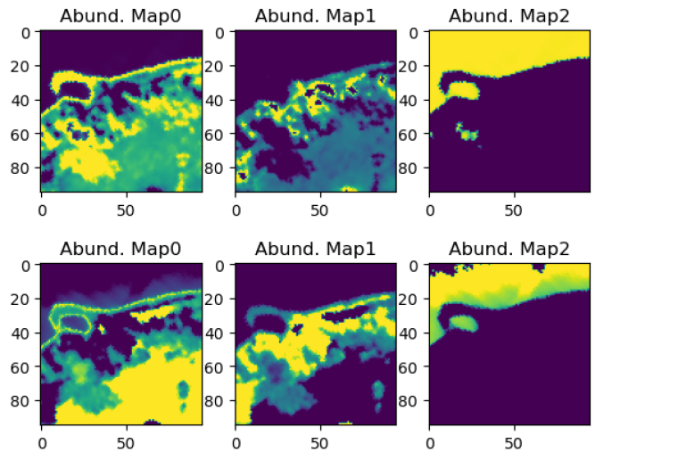
Figure 7: The resultant abundance maps of Samson dataset(Soil, Tree and Water) using objective function MSE(top) and SAD(bottom).

Slide 14
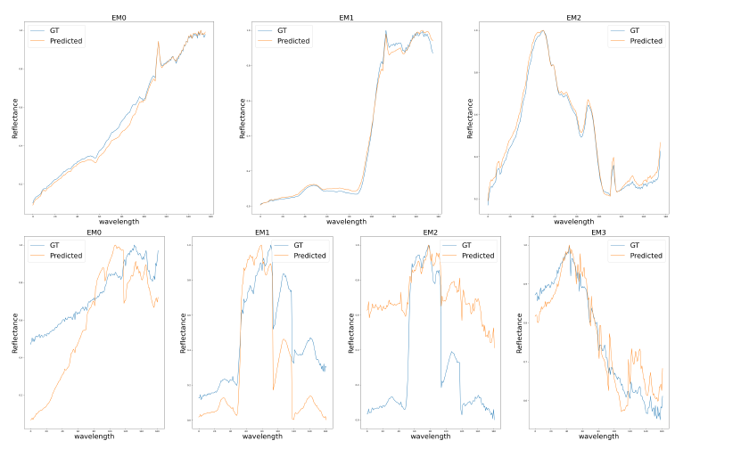
Figure 8: Variability of extracted endmembers for the Samson (top) and Urban4 (bottom)
set as extracted by the autoencoder.

Slide 15
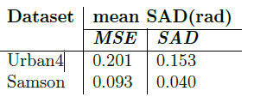
Performance Measure
Metric used to compare the different methods has been the mean SAD from a previously established ground truth for endmember spectral signatures
Table 3: Mean Spectral Angle Distance (SAD) in radians with standard deviation from ground truth

Slide 16
Conclusion
A nonlinear spectral unmixing method based on a deep autoencoder network that applied a general mixture model consisting of a linear mixture component and an additive nonlinear mixture component.
The autoencoder network trained with SAD as objective function performs better than MSE due to scale invariance. The mean SAD tested on Urban4 and Samson dataset is 0.153 and 0.040 respectively.

Slide 17
References
[1] N. Keshava and J. F. Mustard, "Spectral unmixing," in IEEE Signal Processing Magazine, vol. 19, no. 1, pp. 44-57, Jan. 2002, doi: 10.1109/79.974727
[2] R. Heylen, M. Parente and P. Gader, "A Review of Nonlinear Hyperspectral Unmixing Methods," in IEEE Journal of Selected Topics in Applied Earth Observations and Remote Sensing, vol. 7, no. 6, pp. 1844-1868, June 2014, doi: 10.1109/JSTARS.2014.2320576.
[3] Burkni Palsson et al. “Hyperspectral Unmixing Using a Neural Network Autoencoder”. In: IEEE Access 6 (2018), pp. 25646–25656. doi: 10.1109/ACCESS.2018.2818280

